Slide 1
COVID 19 Effects on Air Quality
Daniel Love, Nancy Mathur, Angie Ong & Chad Gielow
2020

Slide 2
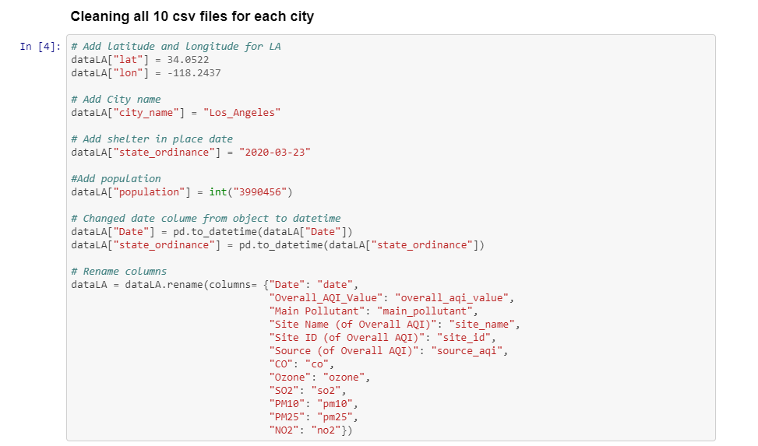
DATA MUNGING
Jupyter Notebook to clean and Mung CSV files
Read files
Update column names
Join Data

Slide 3
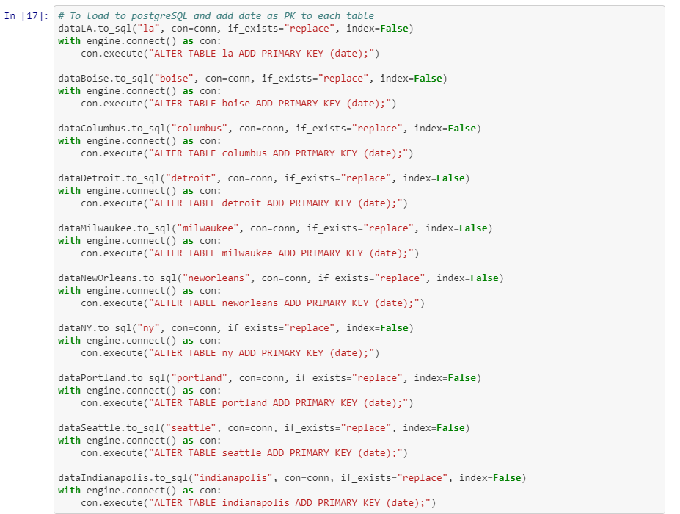
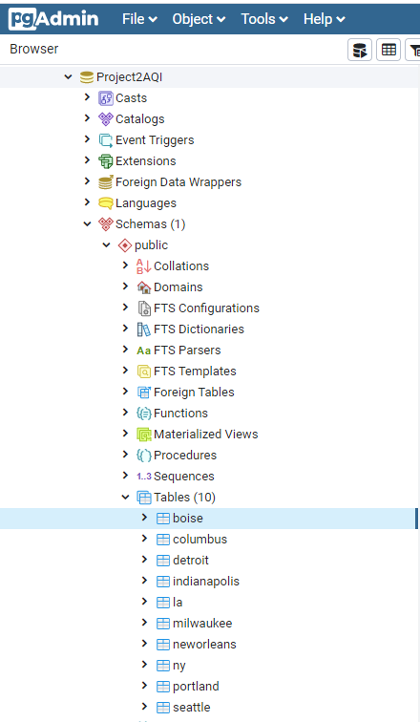
DATABASE
Jupyter Notebook to create Primary Keys
Load data into postgresDB
Use postgresDB to query information for the Flask App API

Slide 4
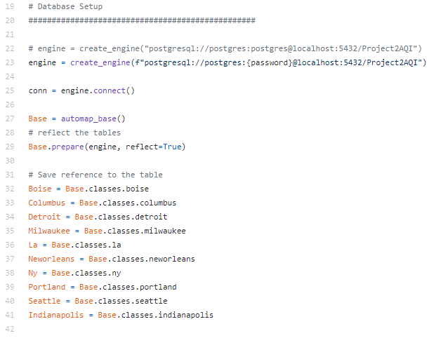
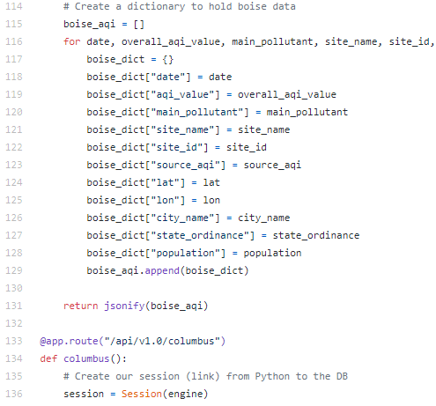
FLASK APP- API
Python to code the FLASK APP
Link with postgresDB
Reference each table
Return data to index.HTML
Create dictionary for each city to hold data

Slide 5
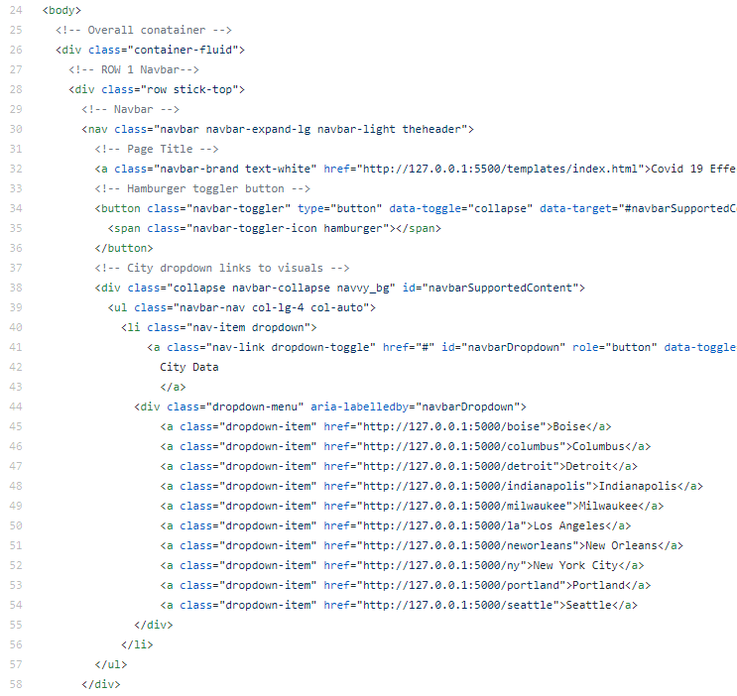
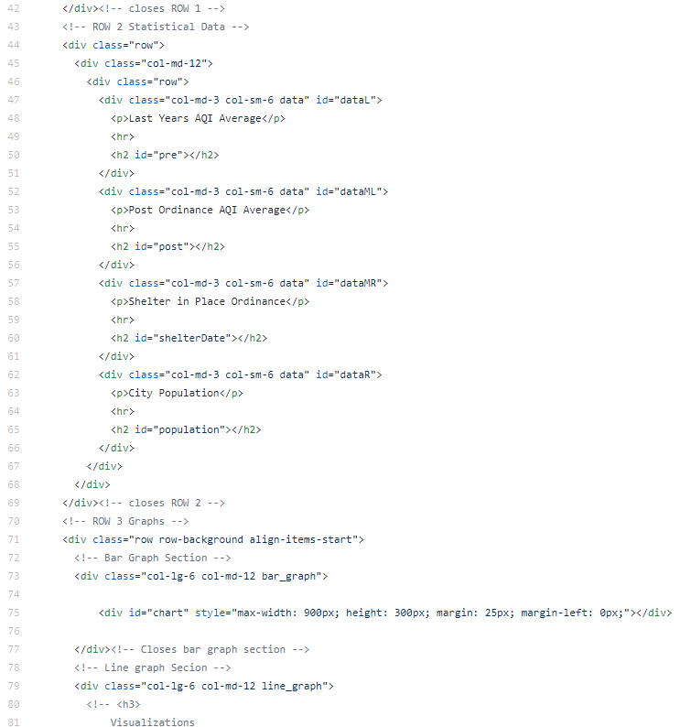
HTML
2 HTML pages
Index is the landing page which holds our choropleth visualization
Used CSS to create the look and feel of our site
Bootstrap to help build the initial framework

Slide 6
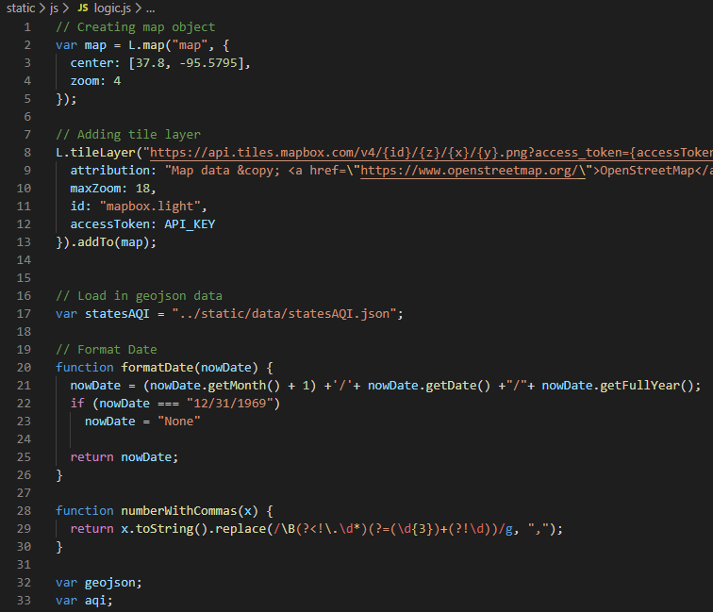
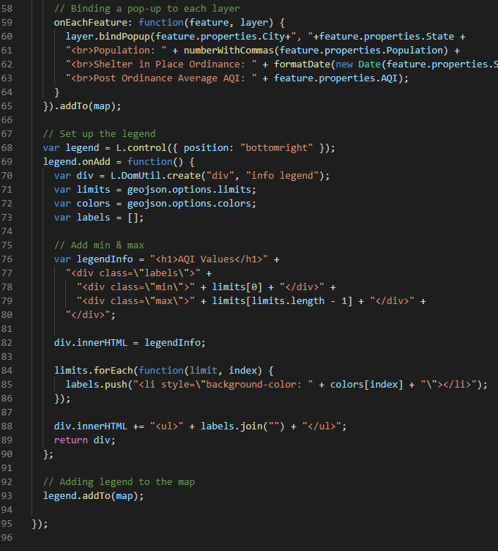
JAVA SCRIPT- INDEX
Used Leaflet library to create choropleth visual
D3 to read the json data
Created pop-up layer to highlight key facts about each states AQI

Slide 7
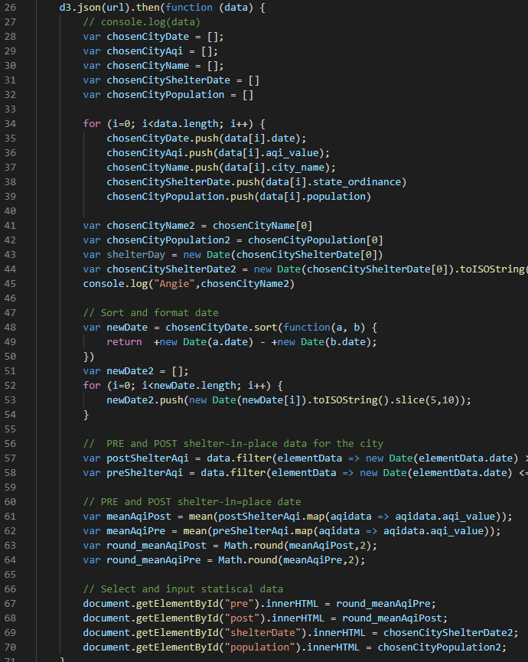
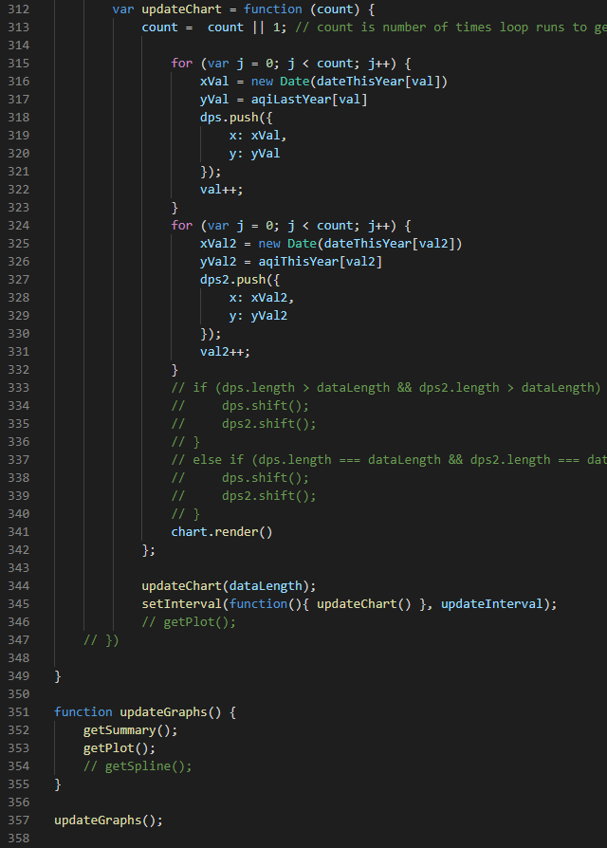
JAVA SCRIPT - DASHBOARD
Visualization updated based on user city selection
Used Echarts & CanvasJS libraries to create the visuals
Coded math to create on page metrics
console.log (everything)

